Slide 1
Automated Collaboration in the Secure Software Development Lifecycle An Overview
Graeme Burnett, SMIEEE, MACM Aug 2018

Slide 2
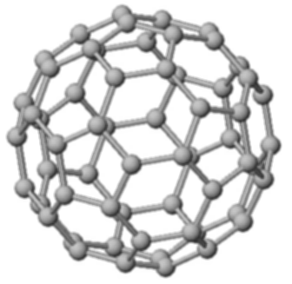
Security Architecture Engagement Process
Architecture capture
Data Lifecycle Analysis
Non-functional Security
Threat modelling/Attack Trees/Abuse cases
Pen tests: scope, engagement, output analysis and walkthrough
Risk Findings Report for Threat Models and Pen Tests
Governance: sign of with business owner and Head of Technology Risk
Notes:
- Explain the artefacts we consume and produce:
- Accurate architecture diagrams
- Network
- Logical
- Application
- Data analysis
- Ownership - identify a business owner. Make sure they are identified in the core system catalog
- Classification Public, Internal, Confidential, Secret
- Volumes, 3x level, synthesis, conflation, enrichment, fusion
- Determine the data owner Technology ‘guardian’ of the data as it maps to WL3, WL4, WL5 within Technology.
- Ensure )II status is updated in the server tag register (what is this?)
- Ensure Saas/Cloud usage is updated in the server tag register (what is this?)
- Define data lifecycle

Slide 3
Automating the Secure Engagement Process
Automated programmatic creation of Epics and tasks
REST interface used to create and link Epics and tasks in a defined order driven by a yaml file.
Consistent process with detailed guidance
Allows flexibility in process and components.
Documentation linked at creation time (standards, checklists and blueprints) - examples showing what good looks like.
Experts and Generalists - Coverage with Depth
JIRA tasks are ordered in sequence defining the process
Each JIRA task has a corresponding JIRA component
This allows Security Architects to select one type of task across engagement epics to provide a specialist skill such as code review.
Higher quality engagement is the result

Slide 4
Collaboration
Tasks created and assigned for downstream systems:
Aha - product roadmap
Eramba - Risk Management
Sharepoint - GDPR Compliance checklists
Supplier Assurance process
Personally Identifying Information (PIA process)
Static Code Analysis process (SAST tooling)
Platform, application and API scanning (Vulnerability Management)
REST API interfaces allow easy collaboration with other core systems ensuring integrity across the estate.
Notes:
Aha is for product lifecycle/roadmap management. The intention is to search for engagement produce names in Aha - if not present, the engagement is inserted into Aha and ticket created on the Zendesk queue for the Aha team so that they can effectively manage data quality.
Eramba is the risk management piece run by Zaman Uddin - it is not currently available but it also should have a reference to the security engagement so that they can list the risk findings reports. Each report will have a reference to the SA Epic
Sharepoint uses the Opendata IO interface and allows us to feed compliance data to centralised sharepoint data.
Supplier Assurance ensure the correct contract and SDO are in place for our solution
PIA process is also accommodated by assigning tasks to the relevant data manager (colleague or customer)
We also drive Coverity and Vulnerability Management

